Slide 1


EXERCISE 5 – PROCESS MINING + LLM INTEGRATION
“Process mining: select a suitable dataset for process mining, learn a petri net model and discuss the properties of the process model.
The integration with LLM according to your creativity is a plus that will be evaluated positive”
Course: Formal Methods 2024/2025
Team: Federica Picca -
Alberta Motca Schnabel

Slide 2

WHAT IS PROCESS MINING AND PROCESS DISCOVERY ?
Process mining combines techniques from data science and business process management to analyze, monitor, and improve processes based on data recorded by information systems. The goal is to discover how business processes are actually executed, identify inefficiencies, bottlenecks, deviations, and provide insights useful for optimizing operations.
In our work, we have concentrated on the Process Discovery field, particularly utilizing the Petri net model.
Process discovery is the technique of constructing a process model from an event log. Event logs are structured records of events that have occurred in a process.

Slide 3
DATASET
The kasterenC_dataset is a dataset commonly used in process mining or activity recognition studies. It represents sequences of activities or events recorded in a smart home, such as cooking, cleaning, watching TV, or sleeping.
The dataset contains event logs capturing the occurrence of activities over time. Each event is associated with specific attributes, such as timestamps, activity types, or sensor IDs.
It is structured in a tabular format CSV, where each row represents an event or activity instance, including details like:
Timestamp: the time when the activity occurred.
Activity name: the specific action or event being recorded.
Sensor: the identifier or type of sensor that recorded the activity, indicating the source of the data
Start/end: The indicators marking the beginning and completion of an activity. "Start" refers to the moment when an activity begins, and "End" refers to the moment when the activity finishes. These may help track the duration of an activity.
The data are collected from real-world smart homes equipped with a variety of sensors.

Slide 4

TOOL: ProM
ProM is an extensible framework that supports a wide variety of process mining techniques in the form of plug-ins
When the dataset is imported into ProM, it's likely transformed, through the plugin Convert CSV to XES, into an event log format that ProM can work with (in this case XES - eXtensible Event Stream format).

Slide 5
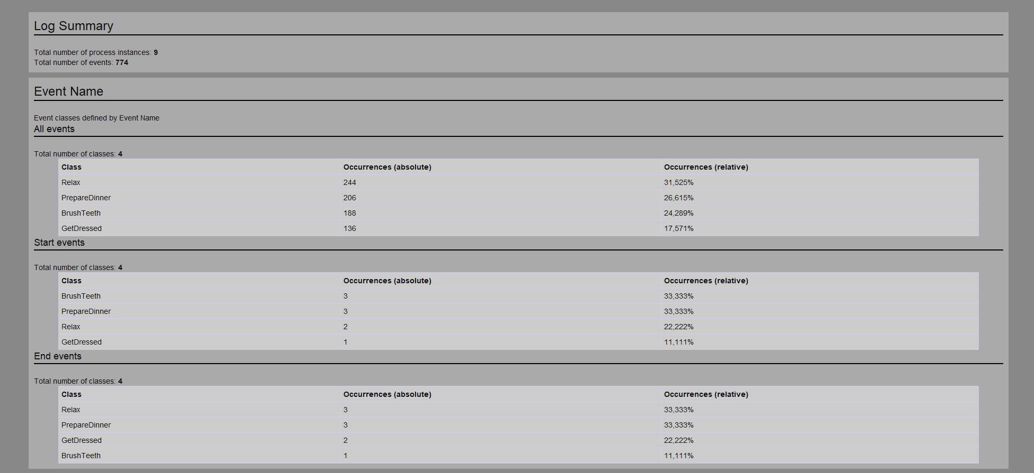
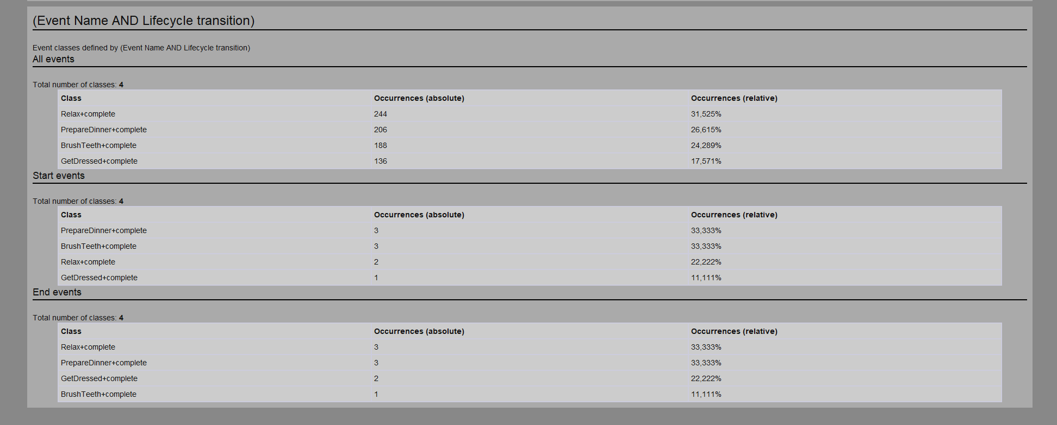
FILTERED DATASET
The filtering is performed according to the following criteria:
removing logs containing only "end" or only "start" (thus keeping only completed activities)
eliminating activities labeled as "None”.
The plugin used in this case is Filter Log using Simple Heuristics.

Slide 6
PETRI NET
The frist step is to load XES file in ProM and select one of the algorithms to generate a Petri Net.
From the available menu, you can choose a process mining algorithm such as:
Alpha Miner: This is one of the simplest and most well-known algorithms for process discovery.
Heuristic Miner: This algorithm is more robust and effective when working with noisy, incomplete, or imperfect datasets.
Inductive Miner: This algorithm is ideal for datasets that are well-structured but may be more complex in nature.
Once the algorithm has been executed, ProM will generate a Petri Net model that reflects the underlying process flow, including places, transitions, and arcs, based on the patterns and relationships detected in the filtered dataset.
The Petri Net created by applying the Alpha Miner algorithm was generated using the Alpha Miner plugin, while the one created by applying the Inductive Miner algorithm was generated using the Mine Petri Net with Inductive Miner plugin.

Slide 7
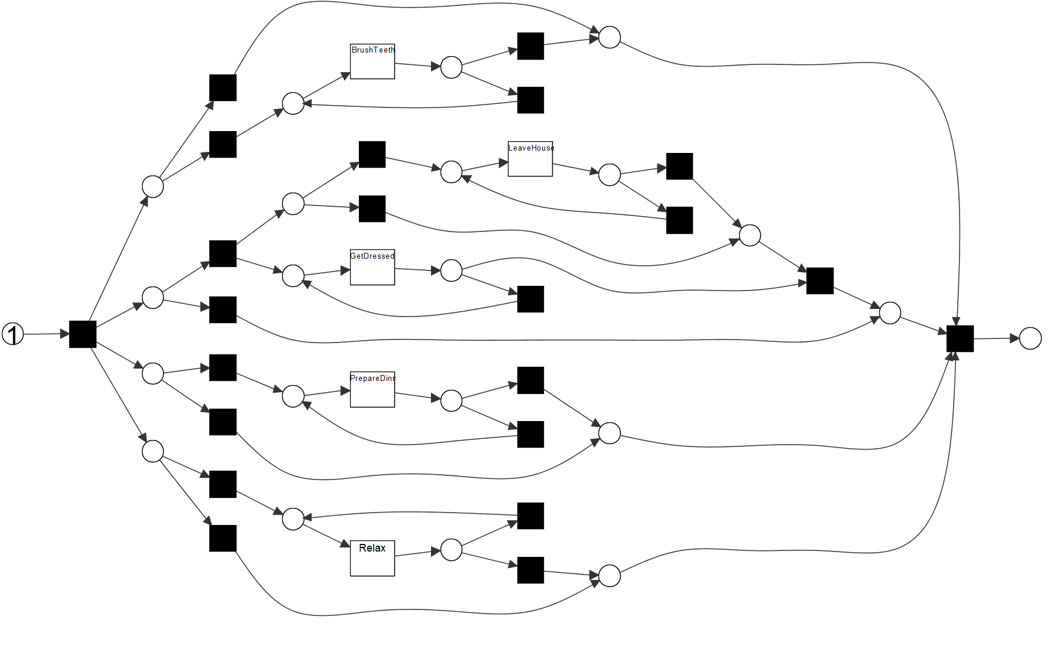
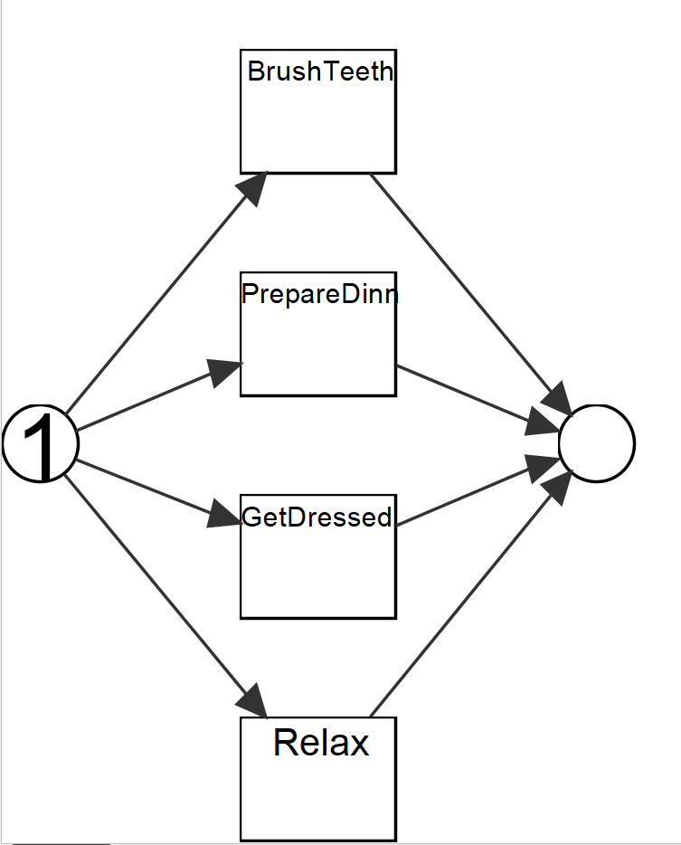
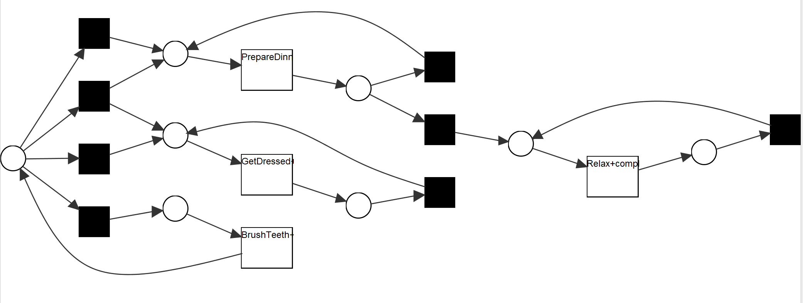
PETRI NETS
INDUCTIVE MINER
Mine Petri Net with Inductive Miner plugin
ALPHA MINER
Alpha Miner plugin
HEURISTIC MINER
Mine for a Heuristic Net Using Heuristic Miner plugin and Convert Heuristic Net to Petri Net plugin

Slide 8
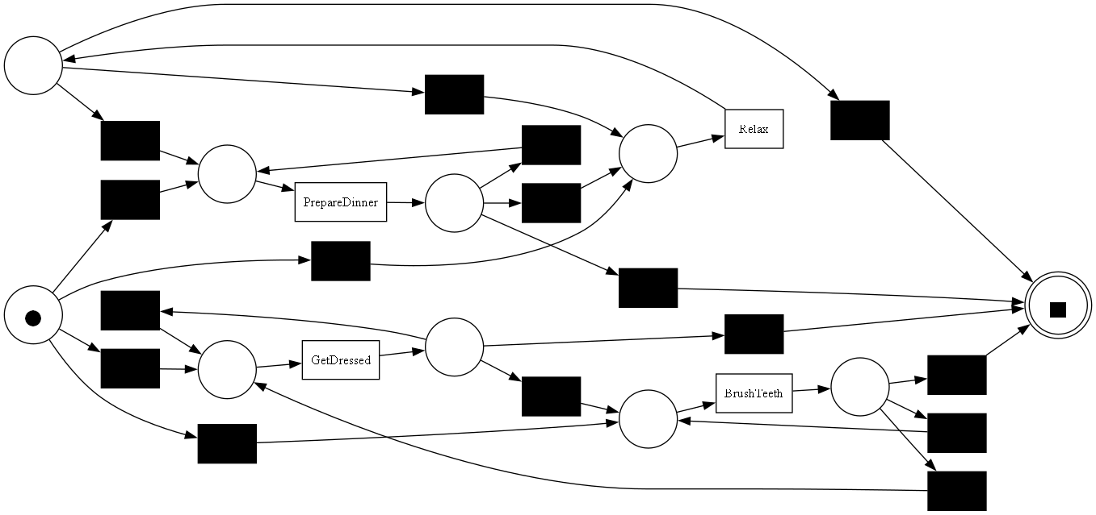
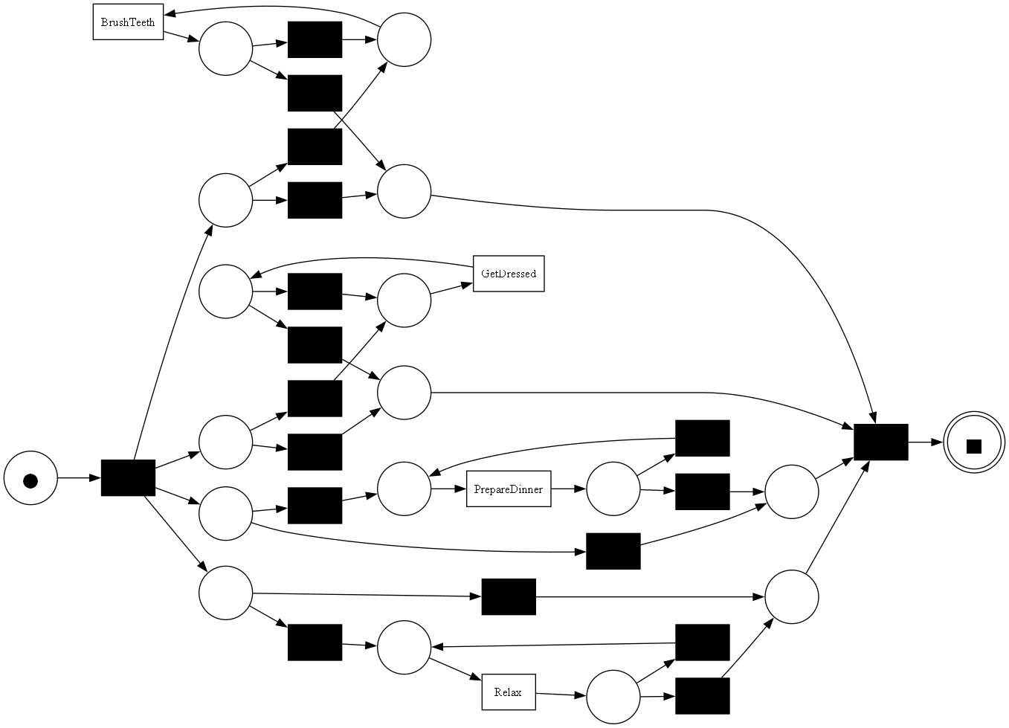
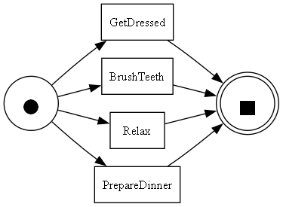

PM4PY
PM4PY implements a variety of process mining techniques, including process discovery, conformance checking, and model enhancement, offering users a comprehensive suite of functionalities to analyze and omprove their processes.
HEURISTIC MINER
pm4py.discovery.discover_petri_net_heuristics(log)
ALPHA MINER
pm4py.discover_petri_net_alpha(log)
INDUCTIVE MINER
pm4py.discover_petri_net_inductive(log)

Slide 9
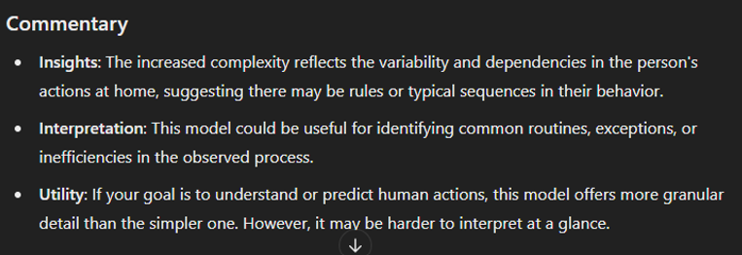
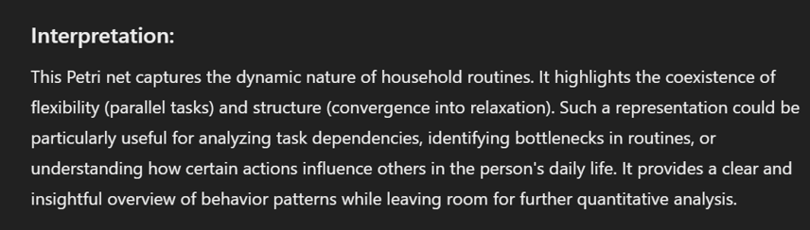
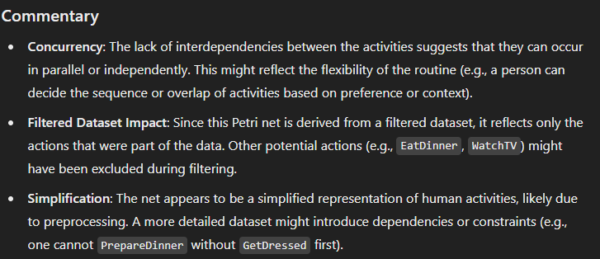
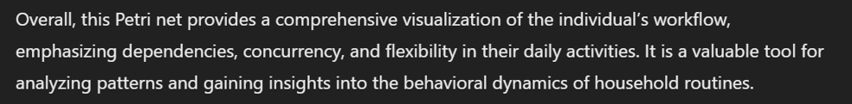
Chat GPT Analysis
An initial step towards integrating Large Language Models (LLMs) involved utilizing ChatGPT to analyze and provide commentary on the networks generated using the two tools applied. This approach aimed to leverage ChatGPT's advanced natural language processing capabilities to interpret the outputs, highlight key features, and offer insights or observations that could facilitate further evaluation and understanding of the generated networks.

Slide 10
METRICS AND PROPRIETIES
TOOL | ALGORTYTHM | FITNESS | PRECISION | GENERALIZATION | SEMPLICITY | WORKFLOW | SOUNDENSS
PROM | APLHA | / | / | / | 0.75 | Yes | Yes
 | INDUCTIVE | 1 | 0.26 | 0.96 | 0.79 | Yes | Yes
 | HEURISTIC | / | / | / | 0.8 | No | No
PM4PY | ALPHA | 0.07 | 1 | 0.93 | 0.61 | Yes | Yes
 | INDUCTIVE | 1 | 0.26 | 0.69 | 0.7 | Yes | Yes
 | HEURISTIC | 0.96 | 0.53 | 0.63 | 0.61 | Yes | Yes
Analyze with Woflan
Replay a Log on Petri Net for Conformance Analysis
Measure Precision/Generalization
Analyze Structural Property of Petri Net
pm4py.conformance.fitness_alignments(log, net, initial_marking, final_marking )
pm4py.conformance.precision_alignments(log, net, initial_marking, final_marking)
pm4py.algo.evaluation.generalization.algorithm.apply(log, net, initial_marking, final_marking)
pm4py.algo.evaluation.simplicity.algorithm.apply (net)
check_is_workflow_net(net)
pm4py.analysis.check_soundness(net,initial_marking, final_marking)

Slide 11
INTEGRATION OF LLM
FLAT-T5 LARGE
BLOOM
CHAT GPT

Slide 12
PROMPT DESCRIPTION
log_description = I have sensor logs that describe a person's movements and actions. The logs include timestamps, states, and transitions: Logs: <string key="concept:name" value="Bathtub"/> <event> <string key="concept:instance" value="229"/> <string key="concept:name" value="BrushTeeth"/> <string key="lifecycle:transition" value="complete"/> <date key="time:timestamp" value="2008-11-20T01:34:00.000+01:00"/> </event>
petri_net_description = The Petri net represents the following transitions and states: - States: start, end - Transitions: - Start -> BrushTeeth ->end - start -> GetDressed -> end - start -> Relax -> end - start -> PrepareDinner -> end
Metrics: - Fitness: 0.071 - Precision: 1 - Generalization: 0.926 - Simplicity: 0.61
prompt = You are provided with a set of sensor logs and a Petri net model with the following transitions and metrics: Logs: {log_description} Petri Net Model: {petri_net_description} Based on this information, answer the following questions: 1. Are there any discrepancies or missing transitions between the states? If so, describe them in detail.

Slide 13
COMPARISON BETWEEN MODELS
1. Are there any discrepancies or missing transitions between the states? If so, describe them in detail.
Yes | The transitions are not inconsistent. The transitions are not missing. | it appears that the Petri Net is missing some transitions (such as Relax) and includes unnecessary ones (such as PrepareDinner), causing a mismatch
2. How would you improve the fitness score of the Petri net based on the provided logs?
0.926 - Simplicity: 0.61 | The first thing to do is to remove the transitions that are not relevant to the problem. For example, the transitions that are not related to the problem are the transitions that are not related to the start state. | To improve the fitness score, the Petri Net should align better with the logs by removing unnecessary transitions (e.g., PrepareDinner), adding missing ones (e.g., Relax), and ensuring the transitions follow the correct sequence based on the log timestamps.
3. What could be the impact of the model's high precision (1.0) on the generalization? Do you think the model is overfitting, and if so, how can it be adjusted to improve generalization?
Generalization: 0.926 - Simplicity: 0.61 | The model is overfitting because it is not learning the data. | A precision score of 1.0 indicates strict adherence to the logs, but it risks overfitting, which can limit flexibility; improving generalization involves relaxing precision slightly and incorporating more diverse log data to account for plausible but unseen behaviors.
4. Based on the given logs and Petri net, are there any additional transitions or states that should be added to better reflect the behavior captured in the logs?
No | The transitions and states in your Petri net model are correct. | The Petri Net should be updated by adding missing transitions like Relax, refining existing ones (e.g., BrushTeeth, GetDressed), and incorporating more granular states or future actions to better align with the logs
FLAT-T5 LARGE | BLOOM | CHAT GPT

